Slide 1
KAGGLER’S ANALYSIS 2018
TEAM MEMBERS:
AKHILA.K
ANKITA BAGESHWAR
HARSHA SALGUNAN
JIYA JACOB

Slide 2
OBJECTIVE:
To analyse the trends and popularity followed by Kagglers.

Slide 3
KAGGLERS
Online community of data scientist and machine learners
Owned by Google
What can you do in Kaggle?
Download or publish data sets
Take part in competitions or host a competition.
To explore a dataset using R or Python codes .
View the codes or analysis of other users in Kaggle.
Attend Micro courses(its free and they provide certificates)

Slide 4
KAGGLER ANALYSIS 2018
Dataset-23,861 rows of data from Kaggle website
Popularity of Kagglers among nationalities
Most preferred programming language’s of Kagglers.
Proportion of time spent in various stages of a project.

Slide 5
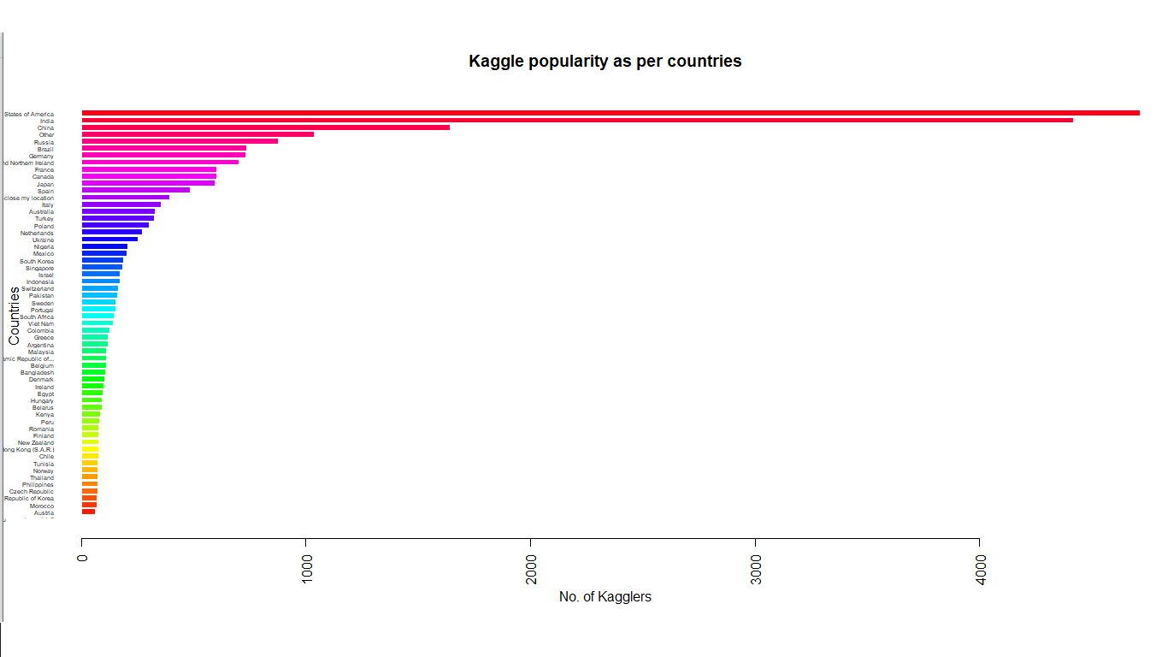

Slide 6
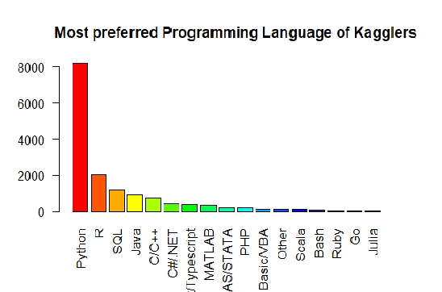

Slide 7
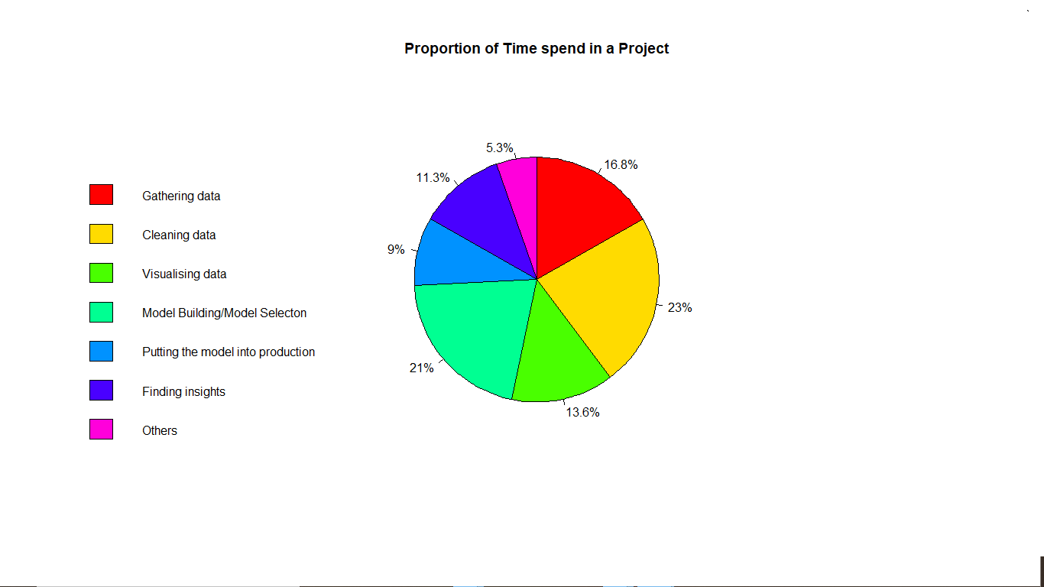

Slide 8
CONCLUSION
Most amount of Kaggle users are from U.S ,followed by India.
Python is the most used language in Kaggle.
The most amount of time is consumed in cleaning of data and then model selection, during a typical data science project.

Slide 9
THANK YOU

